Slide 1
DEV JATINBHAI PATEL
20CEU0S018
CE076
DBMS ASIGNMENT LAB3

Slide 2
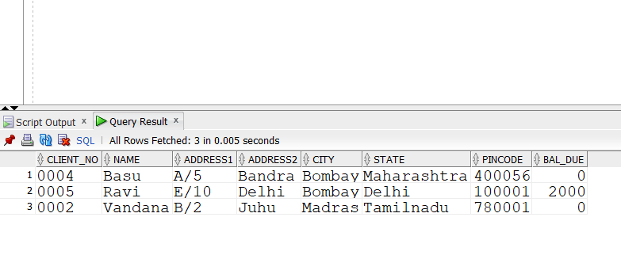
1.Find out the name of all clients having ‘a’ as the second letter in their names.
select *
from client_master
where SUBSTR(name,2,1)='a';

Slide 3
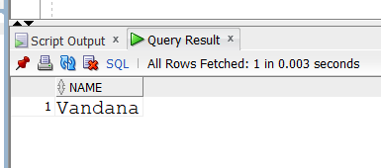
2.Find out the clients who stay in a city whose second letter is a.
select
name from client_master
where SUBSTR(city,2,1)='a';

Slide 4
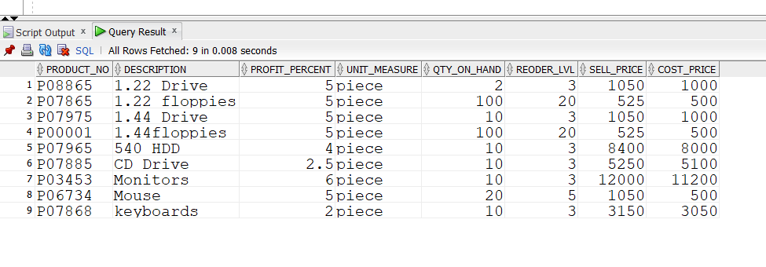
3.List the products in sorted order of their description.
A)select
from product_master
order by description;

Slide 5
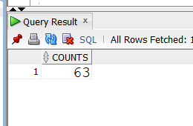
4.Count the total number of orders
select
sum(reoder_lvl) AS counts
from product_master ;

Slide 6
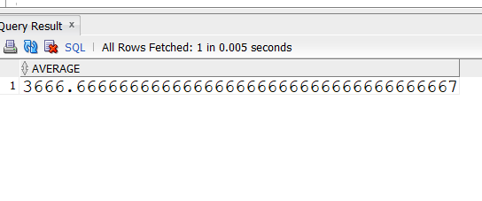
5.Calculate the average price of all the products.
A). select
Avg(sell_price) AS average
from product_master;

Slide 7
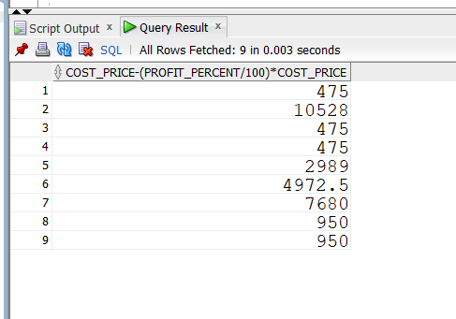
6.Calculate the minimum price of products.
Select
cost_price-(profit_percent/100)*cost_price
from product_master;

Slide 8
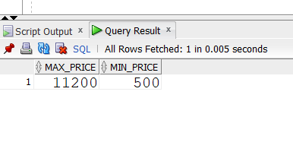
7. Determine the maximum and minimum prices. Rename the tittle as ‘max_price’ and min_price respectively.
select
max(cost_price) max_price , min(cost_price) min_price
from product_master;

Slide 9
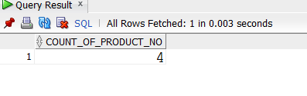
8. Count the number of products having price greater than or equal to 1500.
select
COUNT(product_no) AS count_of_product_no
from product_master
where sell_price > 1500;

